Slide 1
Real-Time Sign Language Detection System
This presentation covers the benefits of sign language interpreters, our approach to sign language detection, data collection and training, and realtime prediction using our system.

Slide 2
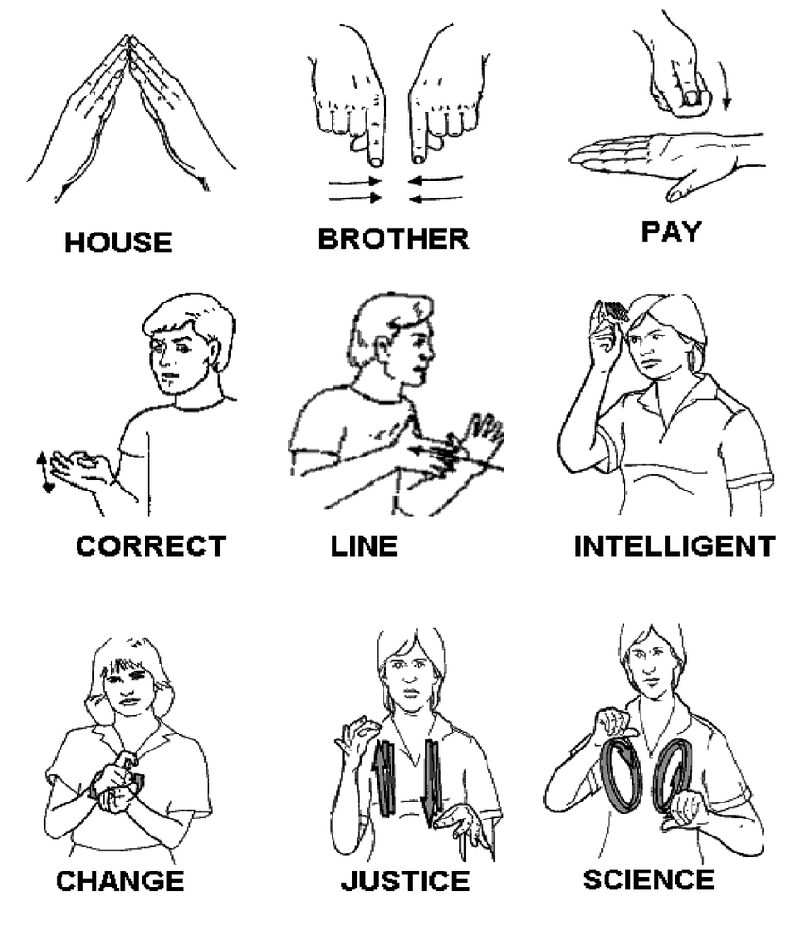
What are sign languages?
Natural languages used by hearing impaired individuals as their primary means of communication.
Examples include American Sign Language, British Sign Language, Indian Sign Language, and Japanese Sign Language.
Certain signs have universal syntax.

Slide 3
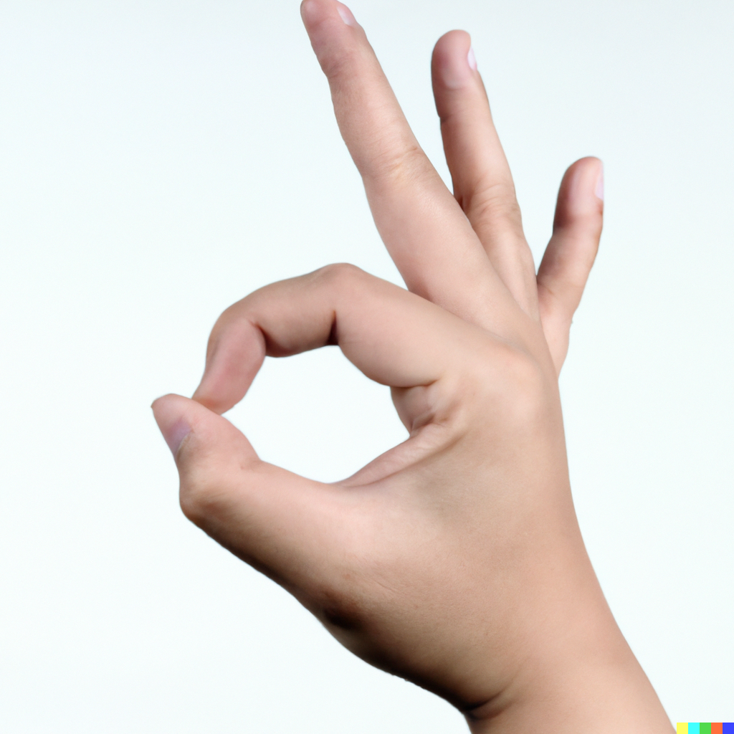
Benefits of sign language interpreters
Bridge language barriers between deaf individuals who use sign language and those who can hear and speak.
Facilitate complete communication for both hearing and deaf people.
Essential in promoting inclusivity within the Deaf community.

Slide 4
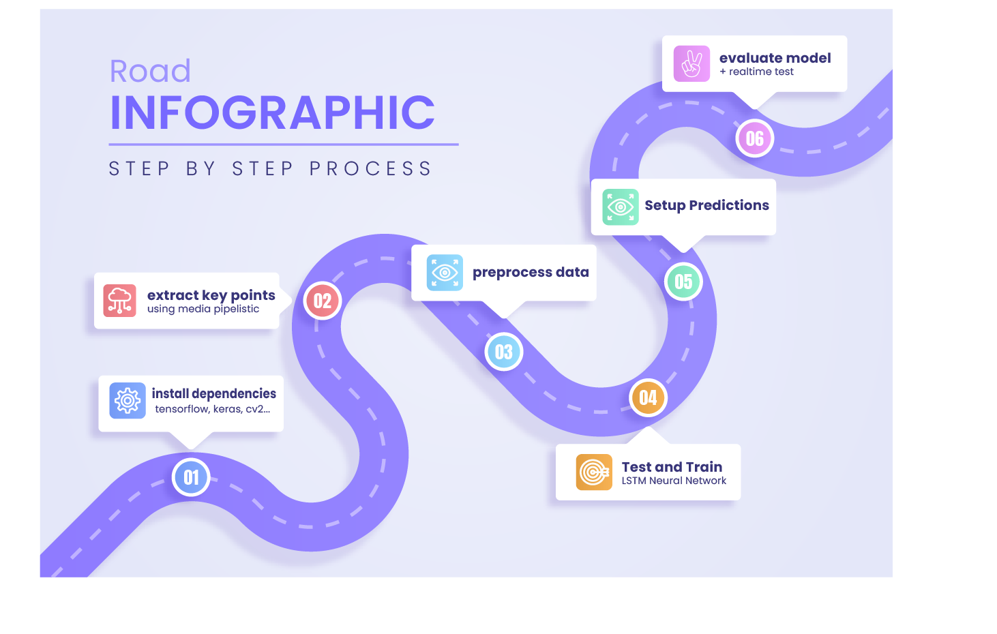
Our approach to sign language detection
Develop a real-time detection system using Python.
Use MediaPipe Holistic to extract key points from hands, body, and face.
Build an LSTM model with TensorFlow and Keras to predict sign language signs.
Integrating these components with OpenCV enables real-time sign language detection using a webcam.

Slide 5
Data collection and training
Collect data on key points from hands, body, and face, saved as numpy arrays.
Train deep neural networks, specifically LSTM models with one layer, to predict the temporal component of sign actions.
Can predict signs from multiple frames, capturing the dynamic nature of sign language and improving accuracy.

Slide 6
Real-time prediction
Integrate MediaPipe Holistic, the trained LSTM model, and OpenCV to enable real-time sign language detection.
Using a webcam, continuously analyze video feeds, identify sign language signs, and provide instant interpretation.

Slide 7
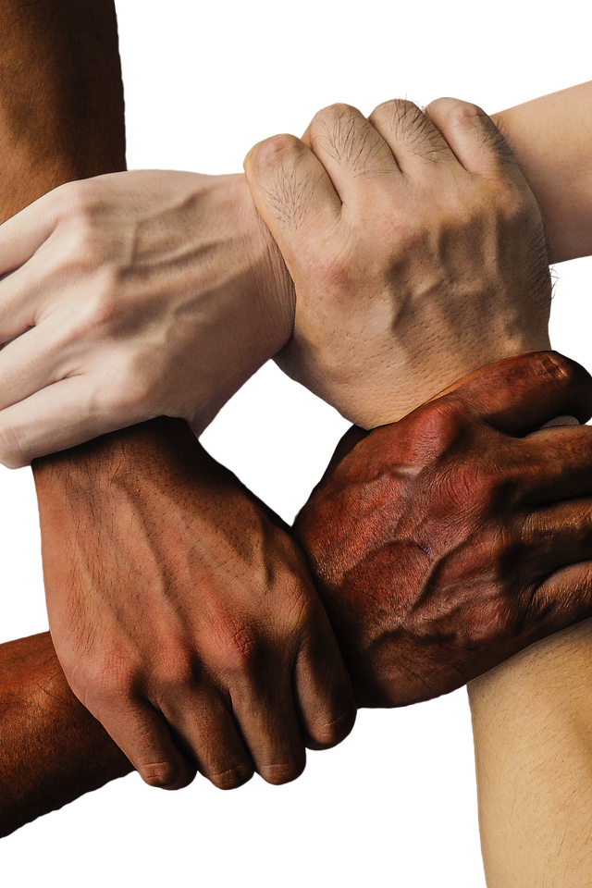
Conclusion
Real-time sign language detection system bridges communication gaps and promotes inclusivity.
Has the potential to revolutionize communication accessibility, creating a more inclusive society where everyone can effectively communicate and understand each other.

Slide 8
Thank you for your time 😊

